Slide 1
Applications Of Op-amp : Zero Crossing Detector
Rajkumar Choudhury

Slide 2
Operational Amplifier (Op-amp)
An Operational Amplifier is fundamentally a voltage amplifying device designed to be used with external feedback components such as resistors and capacitors between its output and input terminals. It is an integrated circuit that can amplify weak electric signals.
Op-Amps usually have three terminals : Two high Impedance inputs and a low impedance output port. The inverting input is denoted with a negative (-) sign and the non-inverting input is denoted with a positive (+) sign.

Slide 3
Zero Crossing Detector (ZCD)
An op-amp detector that has the ability to detect the change from positive to negative or negative to a positive level of a sinusoidal waveform is known as a zero crossing detector.
It is basically a voltage comparator whose output changes when the input signal crosses the zero of the reference voltage level and is therefore known square wave generator as the applied input signal is converted into a square wave.

Slide 4
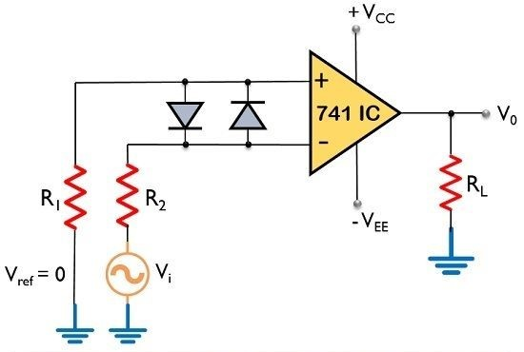
Zero Crossing Detector Circuit

Slide 5
Working
The figure above represents the circuit of a zero crossing detector using inverting op-amp.
Here, the input signal V_{in} is provided to the inverting terminal of the op-amp while the non-inverting terminal is grounded by making use of two resistors R₁ and R₂.
The diodes in the above circuit are called as clamp diodes. These diodes are used to guard the operational amplifier against damage due to an increase in V_{in}.

Slide 6
We know that the reference level is set at 0 and applied at the non-inverting terminal of the op-amp. The sine wave applied at the inverting terminal of the op-amp is compared with the reference level each time the phase of the wave changes.
Firstly, when positive half of the sinusoidal signal appears at the input. Then the op-amp comparator compares the reference voltage level with the peak level of the applied signal, V_{o} = V_{ref} - V_{in}.
As we know V_{ref} = 0, we get. V_{o} = 0 - V_{in}
So, V_{o}= - V_{sat}

Slide 7
Secondly, in case of the negative half of the sinusoidal signal, the op-amp comparator again compares the reference voltage level with the peak of the applied signal.
As this time the circuit is dealing with negative half of the signal, thus the peak will have a negative polarity.
V_{o} = V_{ref} – V_{in} .
As we know V_{ref} = 0 ; we get, V_{o} = 0 -(- V_{in})
So, V_{o}= +V_{sat}

Slide 8
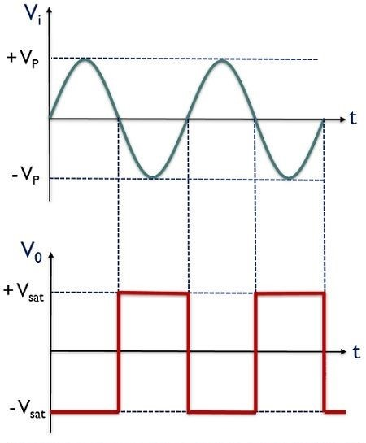
Input And Output Waveforms

Slide 9
Applications Of ZCD
Zero crossing detector circuits can be used to check the condition of an operational amplifier. And also used as a frequency counter and for switching purposes in power electronics circuits.
Zero crossing detection is used in many applications:
Controlled voltage rectifiers
Resonant power supplies
Induction motor speed control and soft starters
AC power controllers

Slide 10
1) ZCD As Phasemeter
A ZCD can be used to measure the phase angle between two voltages. A sequence of pulses in the +ve and -ve cycles are acquired to measure the voltage between the time interval of the pulse of sine wave voltage and second sine wave.
This interval of time is related to the phase difference between the two input sine wave voltages. The use of phase meter ranges from 0° to 360°.

Slide 11
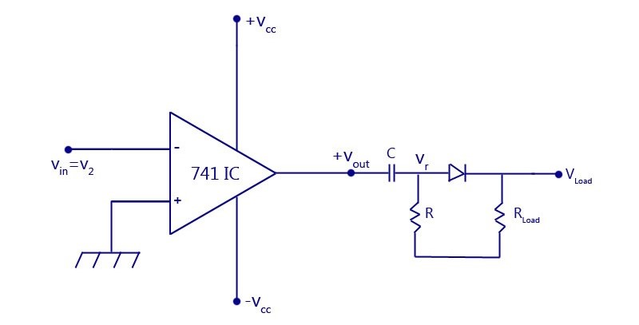
2) ZCD As Time Marker Generator

Slide 12
For an input sine wave, the output of the zero-crossing detector being a square wave, is further passed through an RC series circuit. This is shown in the figure.
If the time constant RC is very small compared to the period T of the input sine wave, then the voltage across R of the RC circuit network called V_{r} will be a series of positive and negative pulses.
If the voltage V_{r} is applied to a clipper circuit using a diode D, the load voltage V_{load} will have only positive pulses and will clip away the negative pulses.
Thus, a zero-crossing detector whose input is a sign wave has been converted into a train of positive pulses at interval T by adding a RC network and a clipping circuit.

Slide 13
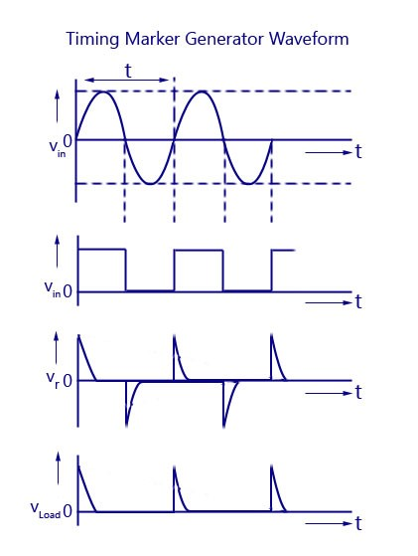

Slide 14
THANK YOU!

